Slide 1
FRAGMENTS
[Insert Background Image]

Slide 2
BASICS
PUZZLE GAME
THIRD-
PERSON
PC

Slide 3
THEME
How deep is your love?
Trial
Self-acceptance
Working through
Past regrets
Reassembly

Slide 4
STRUCTURE
[Insert scribble of HUB
With 3 connected areas
Icons of body parts in areas]

Slide 5
GAMEPLAY
Unlock
Learn
Enter
Collect
Analyze
Solve

Slide 6
GAMEPLAY
Legs -> Wall run
Torso -> Breathe out
Arms -> Hook shot

Slide 7
NARRATIVE
Environmental storytelling
No conversation
Short stories

Slide 8
NARRATIVE
LEG = COWARDICE
Running away
Physically
From responsibility
Fire

Slide 9
TECHNICAL APPROACH
GitHub
Unreal Engine 4.22.2
Blueprints
Decoupled system
Technical debt

Slide 10
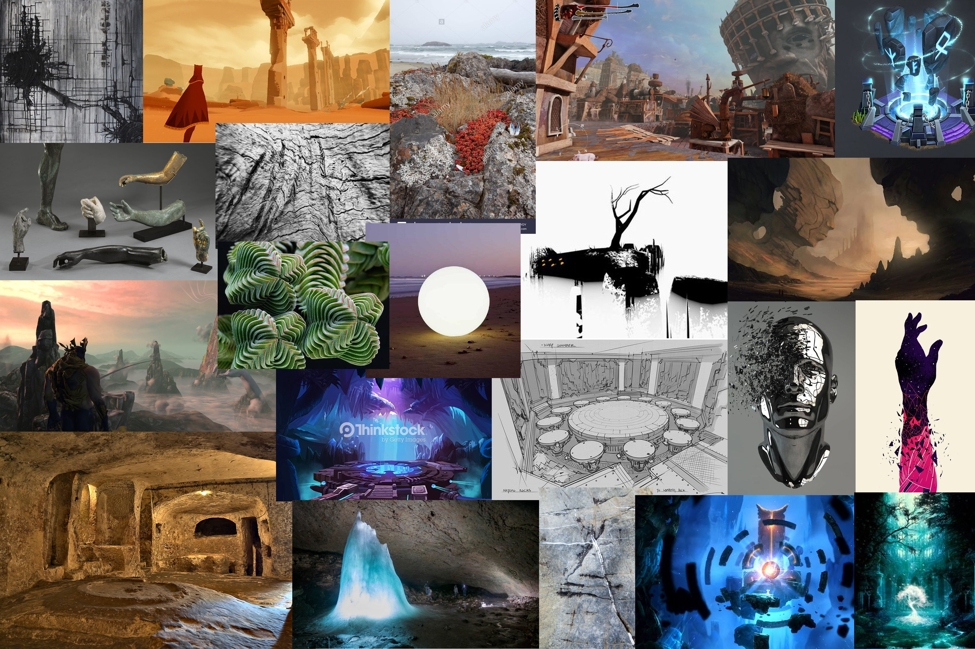
Art
Mood board

Slide 11
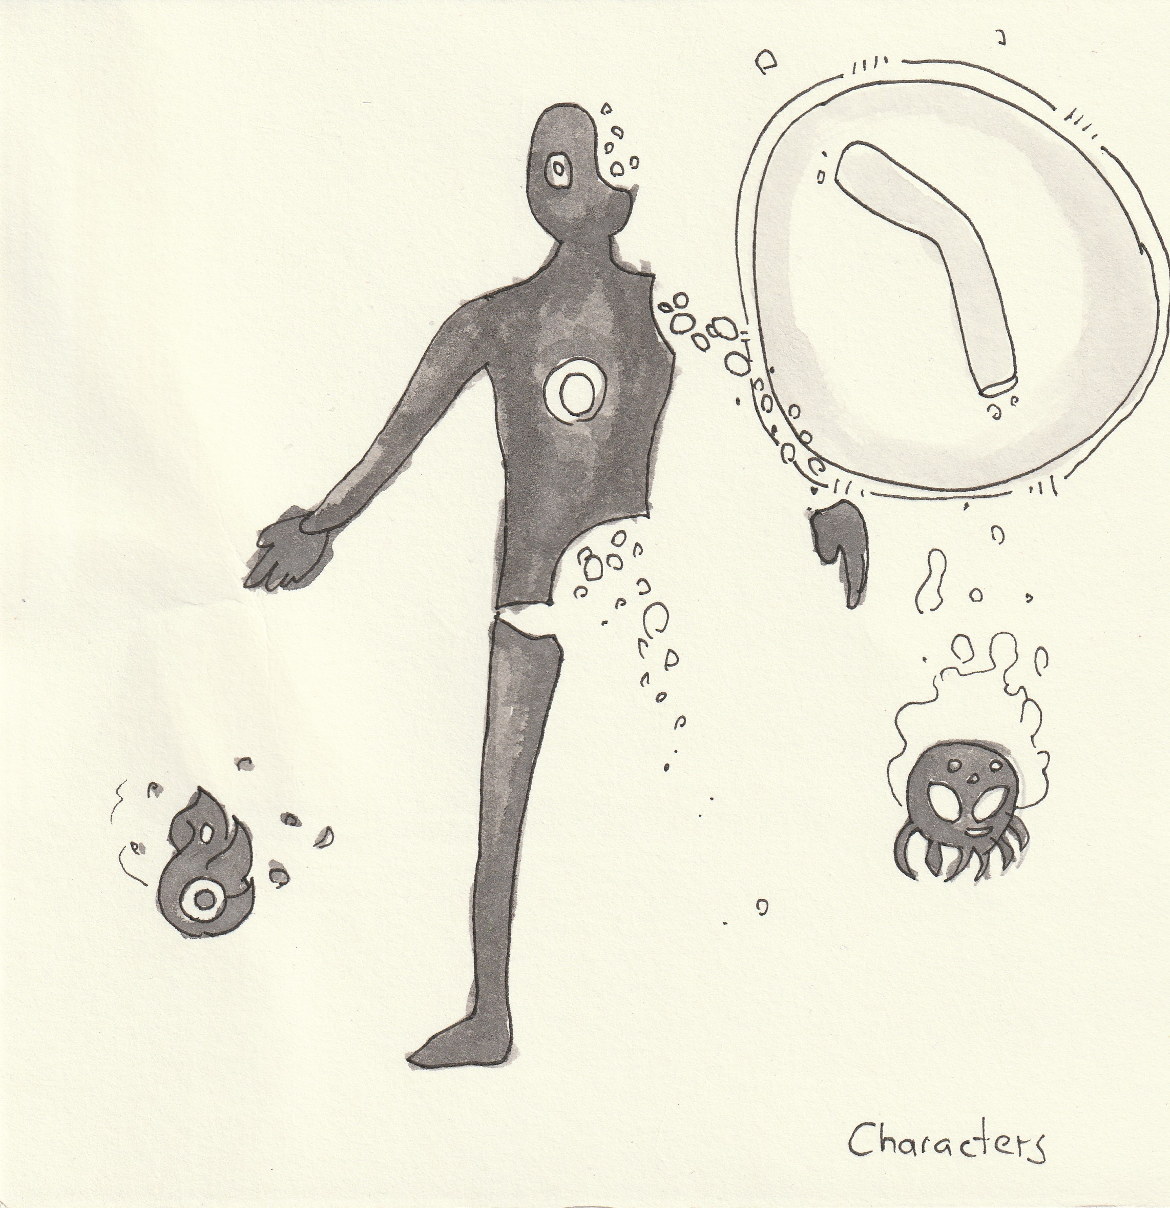
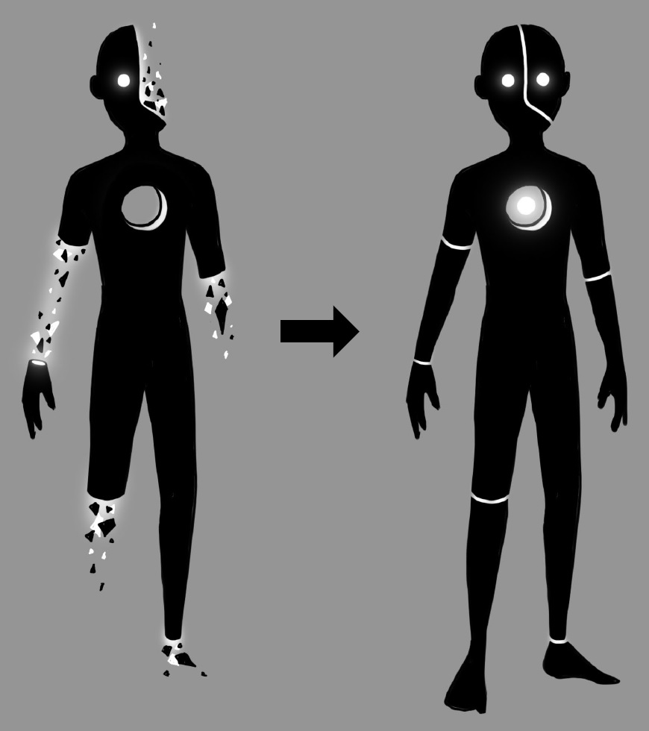
Art
Characters

Slide 12
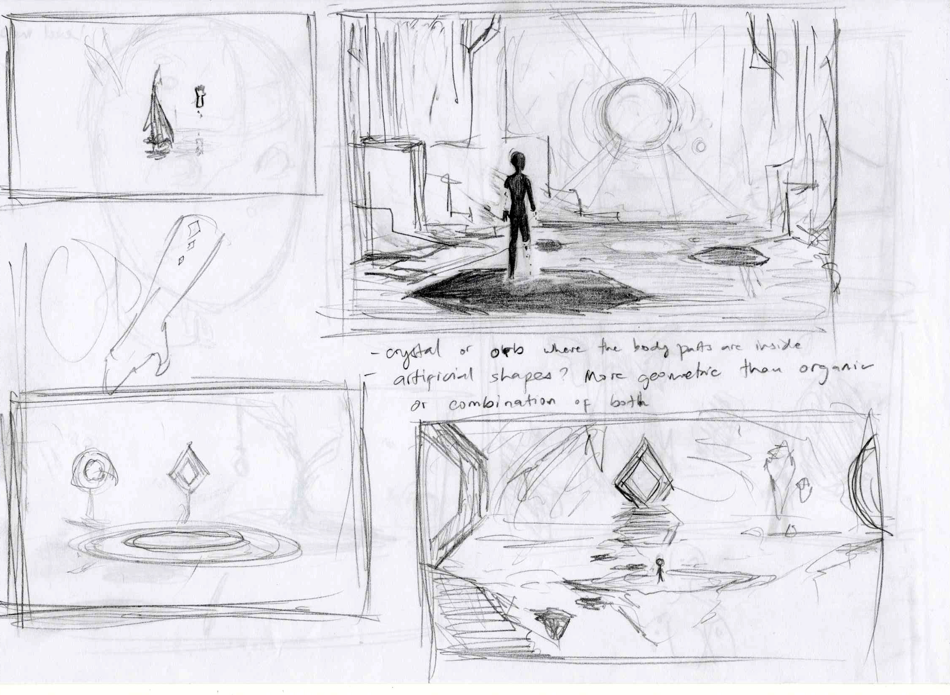
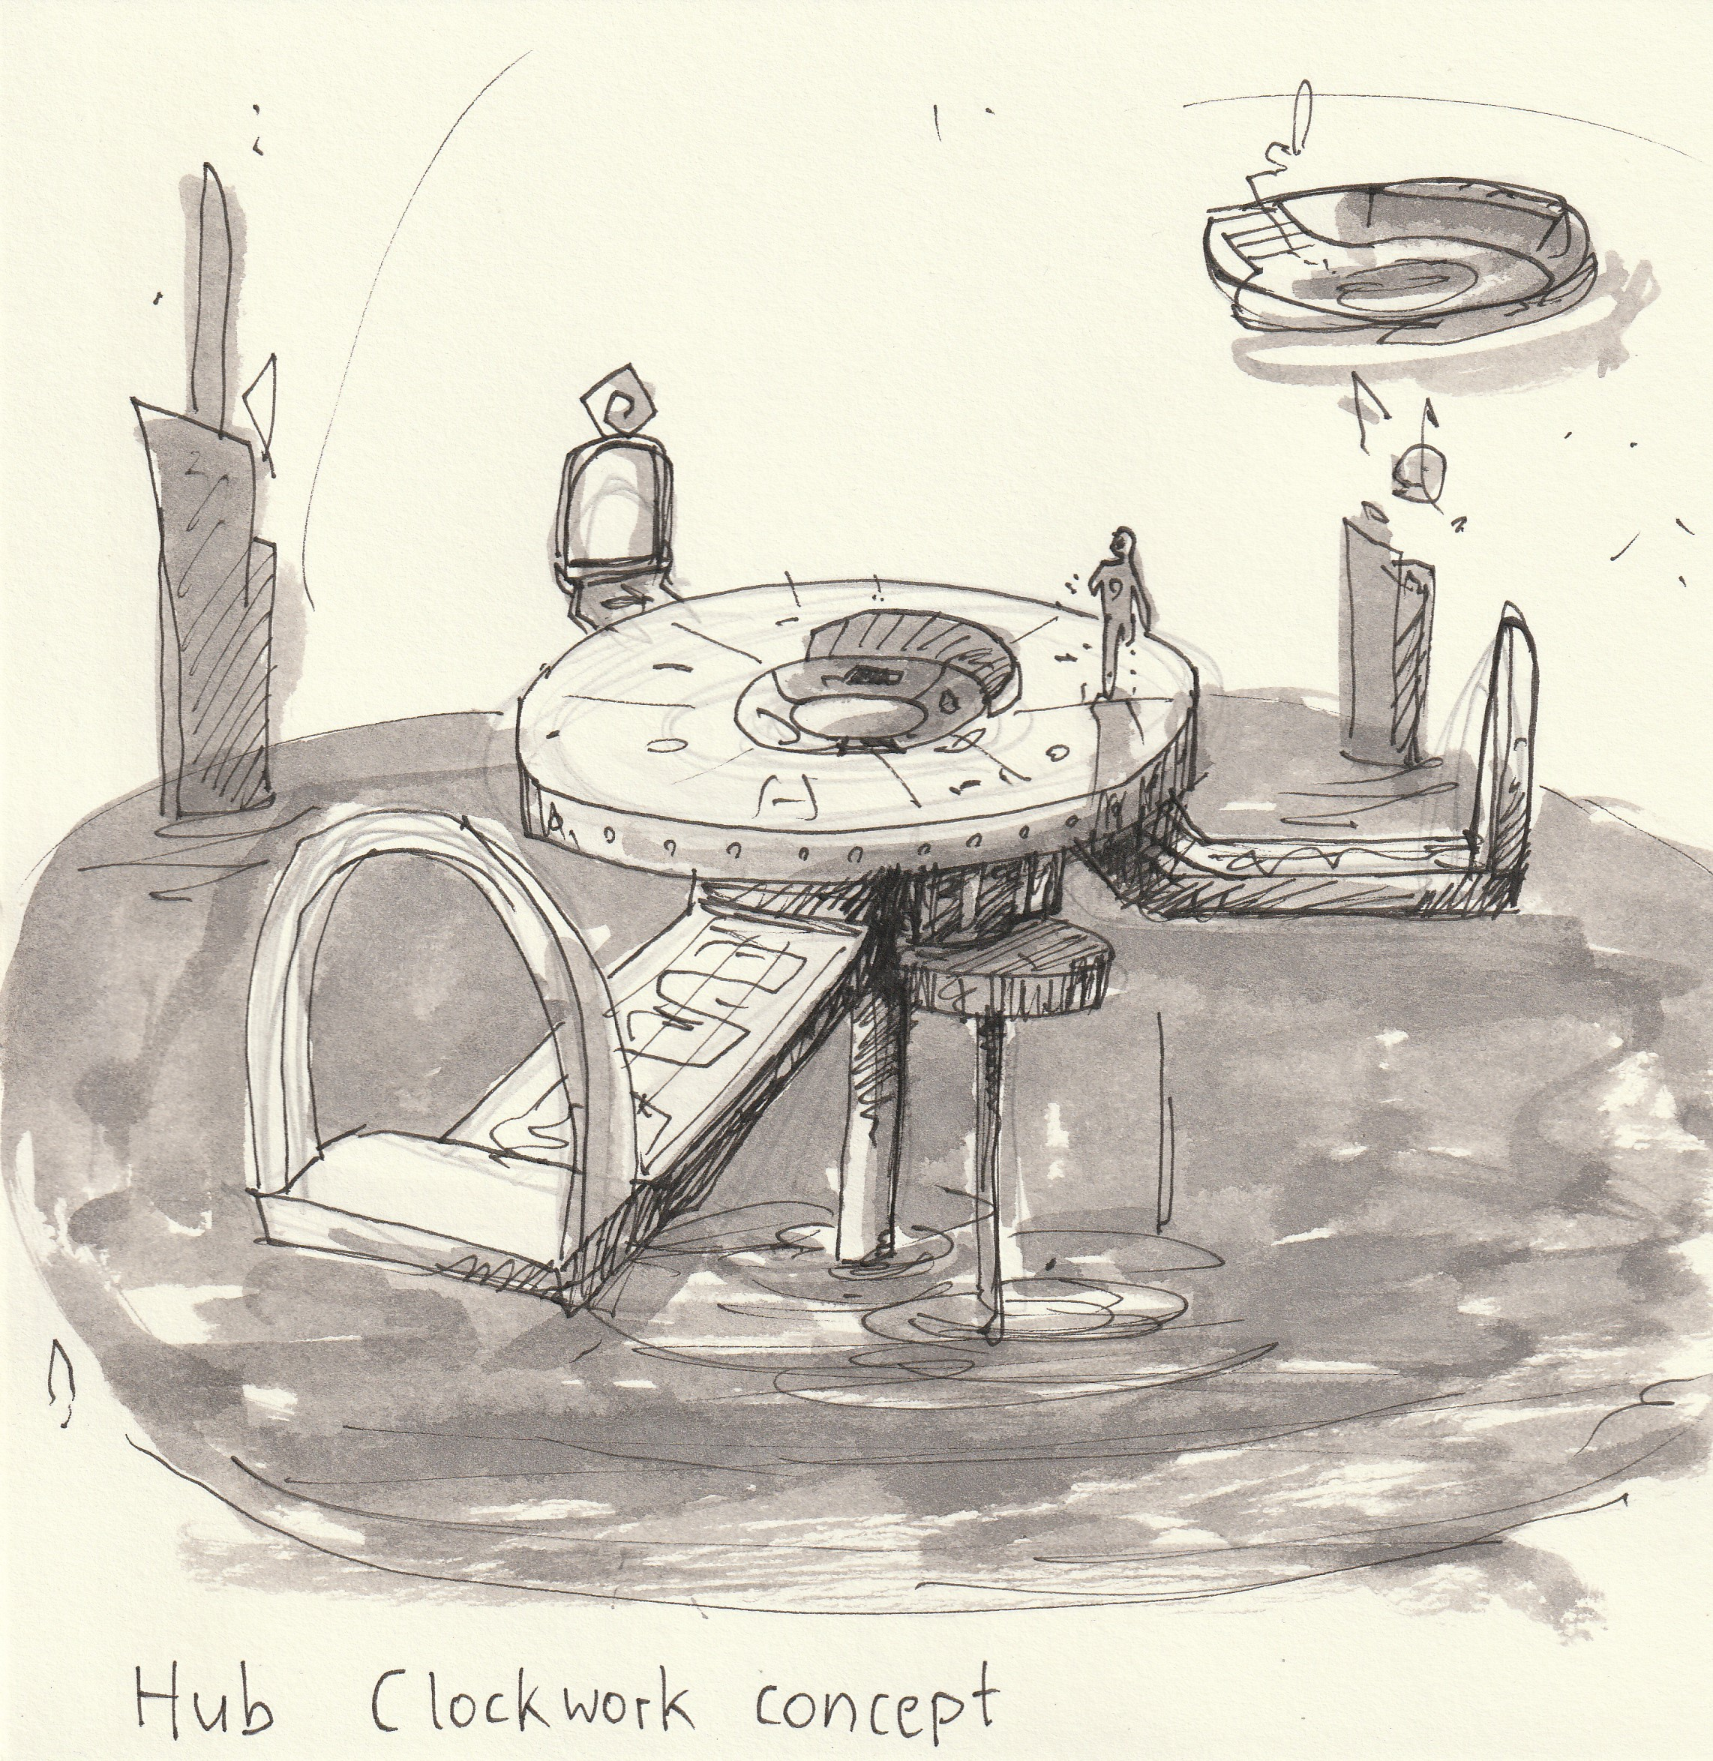
Environment
Art

Slide 13
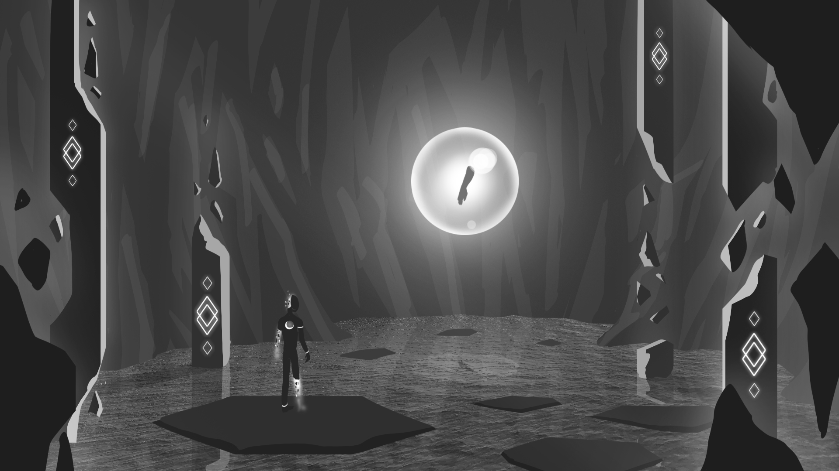

Slide 14
RIPOMATIC
[INSERT RIPOMATIC HERE]

Slide 15

THANK YOU!
Alexander Gerhards
Lead / Artist
Lars Kalthoff
Design
Trixia Quinzon
Artist
Daniel Baracotti
Designer / Sound
Thiago Morano Gerding
Programmer

